Slide 1
EPA Source Apportionment Fall 2025 Capstone
Deeya Datta, Prateek Mishra, & George Whittington
Client: Deron Smith, EPA

Slide 2
Table of contents
01
02
03
04
Introduction
Background information and client
Data
The data given for this project and questions
EDA
Exploratory data analysis
Future Work
Next steps for next semester
Notes:
Deeya Slide

Slide 3
01
Introduction
Our Project Topic and Client
Notes:
Deeya Slide

Slide 4


Source Apportionment
Source apportionment is a "collection of techniques to provide information
regarding how much a source (usually a generalized category) contributes to the
overall pollutant concentration at receptor (usually a monitoring site) (Rizzo, 2010).
The overall goal is to extract latent factors from the data. We can then interpret these factors to identify specific source profiles.
Notes:
Deeya Slide
Source apportionment is a collection of numerical techniques typically used in environmental science contexts. They are designed to figure out where pollutants in a sample come from and how much each source contributes to the total pollution measured .
The main idea of our project is that we have air samples from a mixed cocktail of pollutants, and we need to work backwards to figure out what the original sources were. That source could be something like traffic, or factory emissions, or it could be residential heating. Source apportionment helps us separate and quantify each one based off of ambient observations.
What we get out of this analysis are two main things. First, we get source profiles. We can basically think of these as chemical fingerprints. Each source has its own unique characteristic makeup which we are trying to identify. Second, we get source contributions, which tell us how much pollution is coming from each source over time.
By analyzing the chemical composition of each observation, we will use Positive Matrix Factorization or PMF to extract latent factors from the data. We can then interpret these factors to identify specific source profiles and calculate their corresponding source contributions.

Slide 5



Deron Smith
Mr. Smith is a UGA alumni with a B.S. in Physics and a M.S. in Computer Science from GaTech. He is now a researcher and software developer for the Environmental Protection Agency
Recent projects include an open source tool called the Environmental Source Apportionment Toolkit (esat), and is currently working on a graphical user interface for the toolkit.
Notes:
George Slide
UGA: 2011-2015
Did some jobs
Started EPA contractor position around the same time as MS, seemed to be doing degree part time, and then was hired full time before wrapping up the MS

Slide 6
02
Data
Provided Datasets and Research Questions
Notes:
Prateek Slide

Slide 7
The Datasets
Baltimore
Baton Rouge
St. Louis
focuses on fine particulate matter (PM2.5) chemical composition (n=630)
focuses on volatile organic compounds (VOCs) rather than particulate matter (n=307)
focuses on fine particulate matter (PM2.5) chemical composition (n=418)
Notes:
Prateek Slide
Given six data files from three different cities. In the data, we are given chemical concentrations and uncertainty values for each species which we can use for modeling. Baltimore and St Louis use particulate matter (PM) while Baton Rouge uses volatile organic compounds.
Particulate matter is a mixture of solid particles and liquid droplets found in the air. Some particles, such as dust, dirt, soot, or smoke, are large or dark enough to be seen with the naked eye.
PM2.5: fine inhalable particles, with diameters that are generally 2.5 micrometers and smaller.
VOCs are airborne gases emerging from fuel and industrial chemicals. This is found in the Baton Rouge dataset.
Baltimore had 630 samples, Baton Rouge 307, and St Louis 418.

Slide 8
Variables Across Cities
City | Category | Count | Specific Species Included
Baltimore | Trace Elements | 17 | Al, As, Ba, Br, Ca, Cl, Cr, Cu, Fe, Mn, Ni, Pb, Se, Si, Ti, V, Zn
 | Ions | 5 | NH₄⁺, K⁺, Na⁺, SO₄²⁻, NO₃⁻
 | Carbon & Mass | 6 | EC, OC, OM, PM2.5
Baton Rouge | VOCs | 41 | BTEX, Alkanes, Alkenes & Isoprene
St. Louis | Trace Elements | 8 | Cd, Cu, Fe, Mn, Ni, Pb, Se, Zn
 | Ions | 2 | SO₄²⁻, NO₃⁻
 | Carbon & Mass | 3 | EC, OC, PM2.5
Notes:
Deeya Slide
Here is a closer look at that data we just mentioned. As you can see from this table, we're not measuring the same species in each city, and that's actually really important for our analysis.
In Baltimore, they measured 17 trace elements like aluminum, lead, zinc, and others. They also captured 5 different ions including ammonium, potassium, and sulfate, plus 6 carbon and mass measurements like elemental carbon and PM2.5 (particulate matter smaller than 2.5 micrograms). So Baltimore gives us a pretty comprehensive picture of lots of particulate matter.
Baton Rouge is pretty different. Here the data focused heavily on volatile organic compounds, or VOCs. They measured 41 different VOCs including BTEX compounds, alkanes, alkenes, and isoprene. Basically, this is a much more chemically specific dataset focused on gaseous pollutants rather than particulate matter.
St. Louis falls somewhere in between. We have 8 trace elements, only 2 ions, and 3 carbon and mass measurements. It's a smaller set overall but still gives us sufficient information to conduct PMF.
Making a note of these differences helps inform us of what kind of profiles we will probably develop in each city. For example, the presence of VOCs tips us off that we are likely picking up on things like vehicle emissions and industrial solvents, while the trace elements possibly indicate road dust and combustion.
Looking ahead, the types of source profiles we develop will look different in each city because each dataset is a unique environments.

Slide 9
Considerations & Challenges
Temporal Resolution & Irregularity
Baltimore:
Irregular daily measurements with frequent multi-day gaps.
Baton Rouge:
Sparse hourly sampling (mostly 03:00 or 06:00) rather than continuous monitoring.
St. Louis:
"Chunked" hourly data (e.g., 00:00–23:00) but with several intraday gaps (missing afternoon blocks).
Notes:
George Slide
A primary consideration for the analysis involves the temporal resolution of the data. None of these datasets represent continuous timelines, which directly informs the modeling strategy.
Baltimore provides daily averages, but the timeline is discontinuous, containing frequent multi-day gaps.
Baton Rouge is characterized by a specific sampling schedule, with measurements occurring predominantly at 03:00 or 06:00 AM. This indicates the dataset captures background or nighttime conditions rather than daytime traffic peaks.
St. Louis offers hourly data, yet it is segmented into specific campaigns with irregular gaps, often missing afternoon blocks.
Given this structure, standard time-series forecasting is not applicable. Instead, the analysis treats each observation as an independent snapshot of air quality rather than a continuous sequence, but it might be possible in the St. Louis given it’s hourly nature.

Slide 10
Considerations & Challenges
Completeness & Detection Limits
Data Integrity:
There were no missing values found across any of the three datasets.
Signal-to-Noise:
However, we identified observations where the instrument uncertainty exceeded the measured concentration.
Handling Low Values:
These "high-noise" points are treated as Below Detection Limit (BDL) but preserved using log-transformation.
Notes:
Prateek Slide
First, we checked the datasets for completeness. None of the three datasets had missing values which means we didnt have to impute or remove samples.
However there were some entries where the uncertainty measure was larger than the measured concentration. “Signal to noise” issue, noise>signal, unreliable. Still useful, but have to treat them differently.
Solution: Treat them as BDL but not deleting them. We use a log transform to preserve them instead.

Slide 11
Research Questions
Input Data Analysis
Source Apportionment Modeling
Uncertainty Integration
How can the input data be effectively analyzed and pre-processed to identify key features?
Can we calculate latent Source Profiles and quantify their Contributions using a standard apportionment model?
How can we utilize the paired measurement uncertainty into the model to refine our estimates and assess potential error?
Model Evaluation
Environmental Interpretation
How can we evaluate the results of multiple models (metrics, plots) to ensure stability?
What physical conclusions can we make about the real-world pollution sources based on the model outputs?
Notes:
Deeya Slide
Here are the specific research questions guiding this analysis. We have five main areas we're focusing on.
First is input data analysis. Before we can even run PMF, we need to figure out how to effectively analyze and pre-process this data. We need to determine what features are actually important and if there are any species we should exclude.
Second, the actual source apportionment modeling. Can we successfully use PMF to calculate our source profiles and quantify our source contributions? This is the core of what our project is investigating.
Third, uncertainty integration. This is really important because we don't want to just ignore measurement uncertainty and pretend our results are more precise than they actually are. Every measurement we have comes with some uncertainty, whether that's from the sensor itself, the sampling method, or natural variability. The question is, how can we incorporate that uncertainty directly into our model in order to refine our estimates and better assess potential error?
Fourth, model evaluation. PMF isn't a one-and-done process. We'll likely run multiple models with different parameters, and we need ways to evaluate them. We need to decide what metric we will use to do this and what plots will help us assess stability.
And finally, environmental interpretation. We want to make real physical conclusions about pollution sources in these cities. The ultimate goal of this whole project is to put our statistical findings back into the context of the data.

Slide 12
03
EDA
Exploratory Data Analysis
Notes:
George Slide

Slide 13
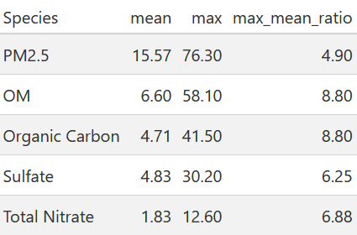
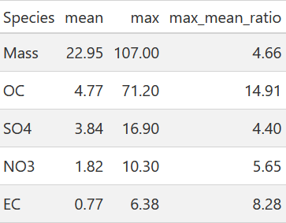
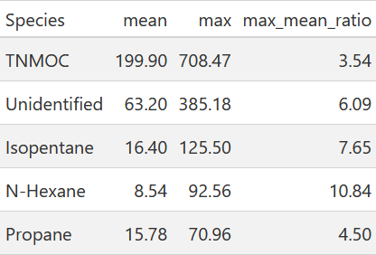
Gaps Between Extreme Values
Baton Rouge
Baltimore
St. Louis
Notes:
George Slide
A primary consideration for the analysis involves the temporal resolution of the data. None of these datasets represent continuous timelines, which changes the interpretation of the results
The most important metric is that Max-to-Mean Ratio.
Across the board, we see peak values that are several times higher than the average.
This tells us that the pollution is highly episodic. It isn't a steady stream; it comes in massive, short-lived plumes.
While these spikes are the 'signal' we want, they create a mathematical problem. If we fed this raw data into the model, the algorithm would be biased by magnitude. It would obsess over fitting these few massive numbers and ignore the subtle correlations in the rest of the data.

Slide 14
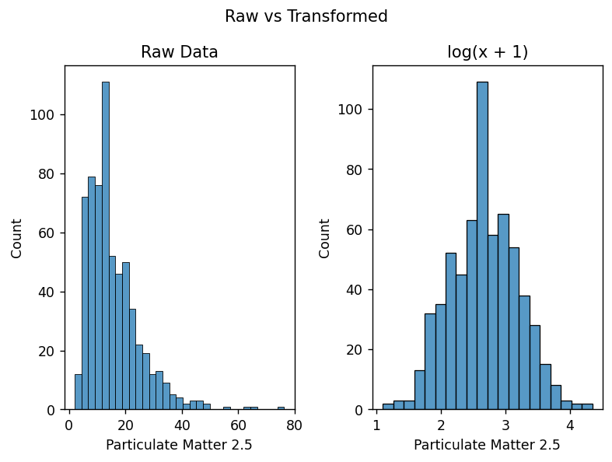
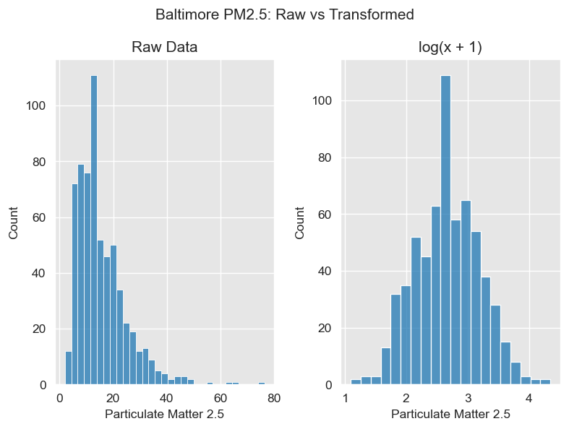
log(x + 1) Transformation
A log(x + 1) is applied to the data to try and bring the data to be more symmetric and to also preserve the non-negative status
Notes:
Prateek Slide
The raw data on the left (showing Baltimore's measured PM2.5 levels) is highly right-skewed — we have many low concentrations and a long tail of higher values.
This skewness violates the normality assumptions many statistical methods rely on. We add 1 to avoid taking the log of zero, because PM2.5 measurements are always non-negative. Because of the extreme values shown previously and a lot of values with lower concentrations than uncertainty values, log transforming keeps all the data while stabilizing the scale. We did this on all datasets and saw improvements in all three cities.

Slide 15
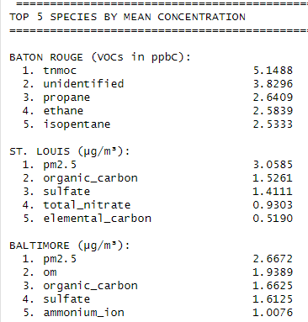
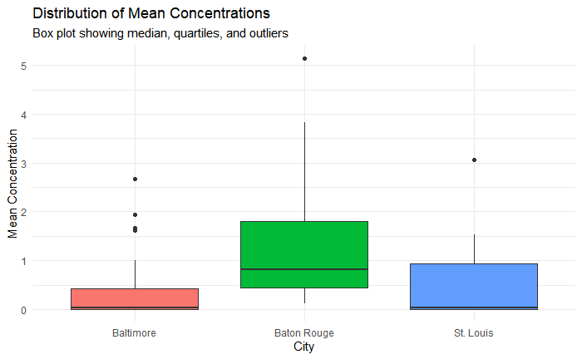
Concentration Distributions
Notes:
Deeya Slide
This box plot shows the distribution of mean concentrations across all the pollutants we measured in each city,
Baltimore sits pretty low overall. The median concentration is close to zero, and we don't see a lot of variability. There are a couple of outliers, but most measurements are clustered in a narrow range. Looking at the top 5 species for Baltimore, PM2.5 leads at about 2.7 micrograms per cubic meter, followed by organic matter, organic carbon, sulfate, and ammonium ion. These are all particulate matter components, which makes sense given what we observed just looking at the sources listed in the Baltimore dataset.
On the right we have St. Louis. The distribution also has a low center of measure but has higher variability than Baltimore. The top 5 here are PM2.5, organic carbon, sulfate, total nitrate, and elemental carbon. Again, these are mostly particulate components, pretty similar to Baltimore but with slightly higher concentrations overall.
Baton Rouge is a different story. The concentrations are higher and more variable. When we look at the top 5 species, it's all VOCs measured in parts per billion. TNMOC, which is total non-methane organic compounds, is the outlier way up at 5.1 ppbc. Then we have unidentified compounds, propane, ethane, and isopentane. These are gaseous pollutants, and they're measured at much higher concentrations than what we're seeing in the other cities.

Slide 16
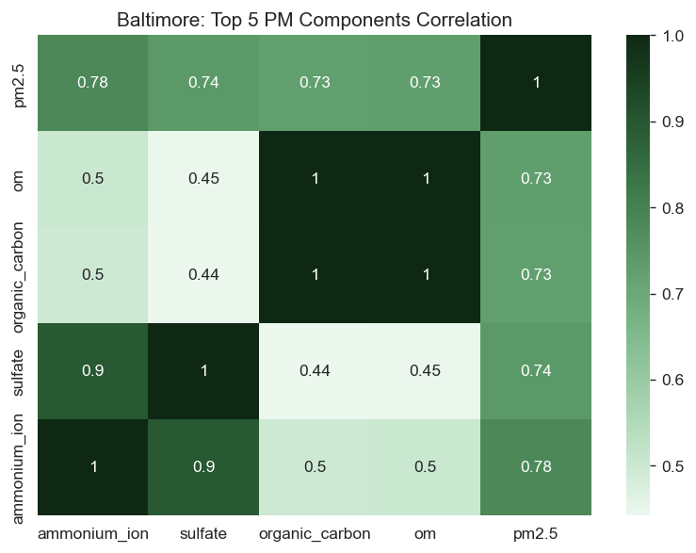
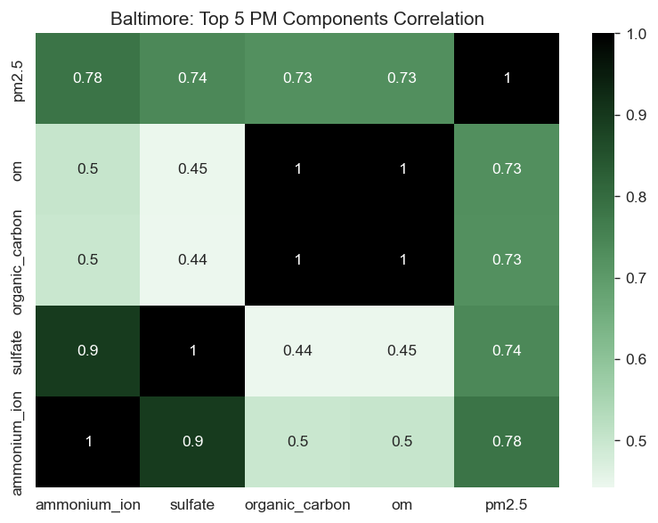
Top Correlations
Organic Carbon and Organic Matter have a perfect correlation of 1.0. This is because OM isn't independently measured, it's simply OC multiplied by a conversion factor to account for the hydrogen and oxygen attached to the carbon.
Notes:
George Slide
For source apportionment, this is a problem. Including both variables means we're double-counting the same information, which causes statistical issues in PMF and wastes a valuable species slot. Each variable should provide unique information to help distinguish sources.
For when we build our model next semester we will keep Organic Carbon - the actual measured value - and drop Organic Matter before running PMF.

Slide 17
04
Future Work
Goals For Next Semester
Notes:
Prateek Slide

Slide 18
How do we plan to implement a model?
What is Positive Matrix Factorization?
PMF separates pollutants into sources and their contributions.
Source Contributions (G): how much each source contributed on each day
Source Profiles (F): the chemical fingerprint of each source
X=GF+E where X is observed and E are residual errors
Why is it a good fit?
-Our data is a mixture of many unknown sources
-PMF handles uncertainty values (low uncertainty are weighted higher)
-It requires no predefined source profiles
-Air quality researchers widely use it, ensuring reliability
Notes:
Prateek Slide
Positive Matrix Factorization is a source apportionment model used to identify hidden pollution sources. Takes our data and outputs two results, source contributions and the source profiles.
Source contributions: How much each source contributed each day
Source profile: the chemical fingerprint of each source
Mathmetically: X=GF+E, where X is our observed data and E is the residual error. We pick a number of sources and the model optimizes values for G (Source Contributions) and F (Source Profiles). Then using a plot we can pick the number of sources that best fits the data while not over/under fitting.
A quick note: PMF is a specialized form of Factor Analysis.
While traditionally Factor Analysis allows for negative values in its mathematical
solution, our context requires a strict non-negative constraint because
physical matter or pollution cannot exist in negative quantities.
Good bc we don’t know the sources, it handles uncertainty, and air quality researchers use it extensively.

Slide 19
Our Next Steps
We are here!
Data Preparation
Model Development
Source Profile Identification
Evaluate Model
01
02
03
Analysis
Create Model
Assess Model
Conducted data cleaning and exploratory analysis to confirm all three datasets are suitable for PMF source apportionment.
Use PMF to create a source apportionment model and calculate source profiles and source contributions.
Evaluate model’s potential error and utilize provided input uncertainty to improve its performance or create new iterations.
Notes:
Deeya Slide
Here is a overview of our project timeline.
Right now, we're in the data preparation phase. This is where we've been doing all the data processing and exploratory analysis you've seen so far. Our goal is to confirm our data is actually suitable for our chosen method PMF. Right now we're checking for issues like values that may be below detection limit, and understanding the structure of what we're working with.
Next is the bulk of our work next semester which is our model development. This is where we'll actually create the source apportionment models using PMF. We'll use that to calculate those source profiles and source contributions for each city.
And finally we will move into model evaluation. We'll be doing the environmental interpretation at this stage, figuring out what these sources actually represent in the real world. We will need to somehow assess how reasonable our results are. This is where we'll utilize that input uncertainty we talked about earlier to either improve the model's performance or create new iterations with different parameters.

Slide 20
Thanks!
Do you have any questions?

